Slide 1

Data Warehouse
Presented by: Mehrin Farzana
ID: 2101013
Date: 08-12-2024
Notes:
Created from: https://www.youtube.com/watch?v=NphMcnU8ymU

Slide 2
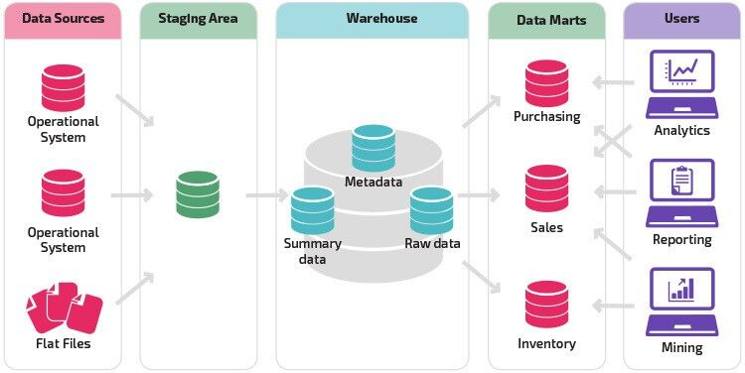
What is a Data Warehouse?
A centralized storage area for data from multiple sources
Acts as a repository for large amounts of data
Allows for further processing and analysis of data
Used to gain useful insights for business growth
? How might a data warehouse differ from a regular database?

Slide 3
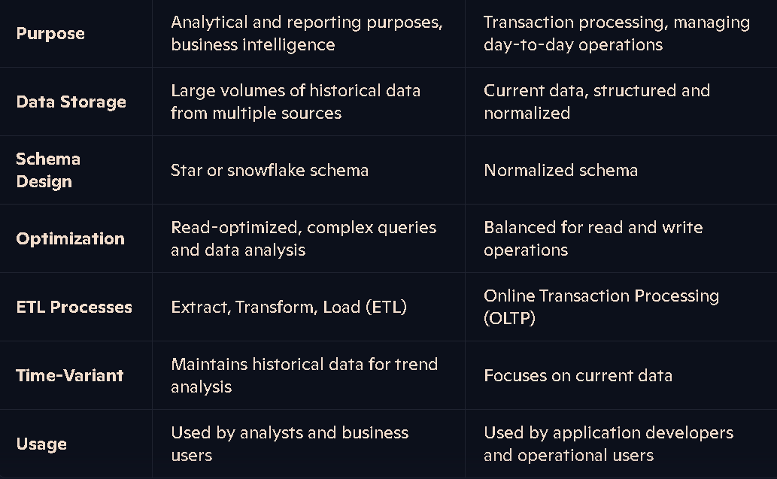
Data warehouse vs Regular database

Slide 4
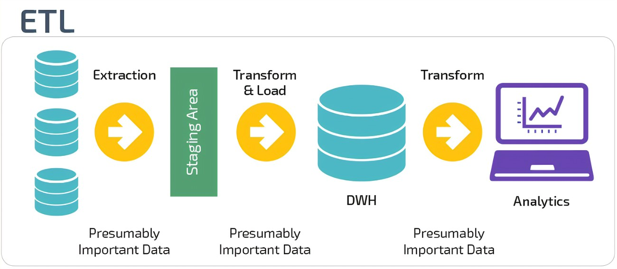
The ETL Process
ETL stands for Extract, Transform, Load
Extract: Collect data from multiple sources
Transform: Clean and process the data
Load: Store the processed data in the warehouse
Real-World Analogy: Potato Warehouse
Similar to a data warehouse in concept
Collects potatoes from multiple farms (data sources)
Stores large quantities in a centralized location
Processes potatoes (cleaning) before storage

Slide 5

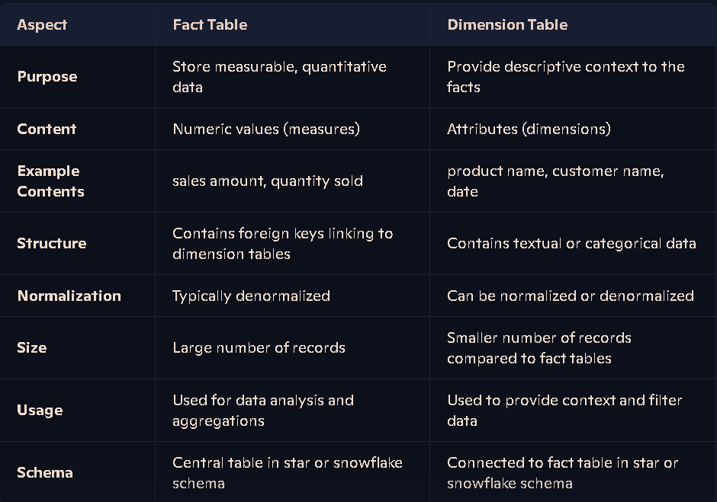
Data Warehouse Models
Examples: Star schema, Snowflake schema

Slide 6
Data Processing and Cleaning
Crucial step after data collection
Involves removing meaningless or corrupt data
Ensures data quality and reliability
Prepares data for analysis and decision-making

Slide 7
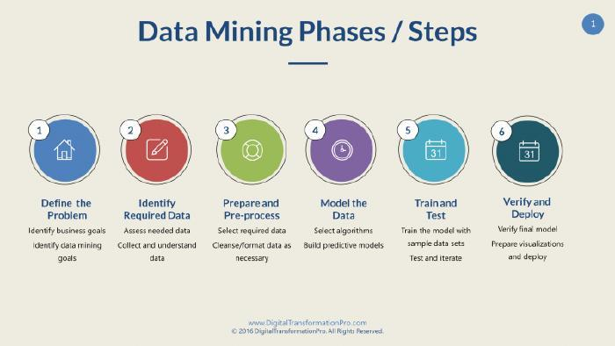
Data Mining and Analysis
Extracting meaningful insights from stored data
Uses tools like Python and R programming
Helps in business intelligence and analytics
Supports data-driven decision making

Slide 8
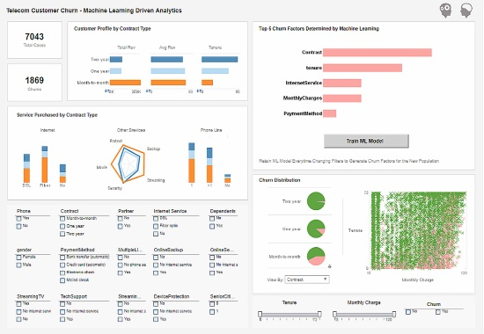
Data Visualization
Creating visual representations of data
Tools used: Tableau, Microsoft Power BI
Helps in easier understanding of complex data
Crucial for presenting insights to stakeholders

Slide 9
Physical vs. Cloud Data Warehouses
Large companies often have physical data warehouses
Smaller companies tend to use cloud services
Cloud options: Google BigQuery, Amazon Redshift
Considerations: cost, scalability, maintenance

Slide 10

Future of Data Warehousing
Increasing importance in the age of big data
Growing integration with AI and machine learning
Trend towards real-time data processing
Focus on data security and privacy

